Slide 1
PROMETHEUS: Neural network trees
Comp 400
Marwan Jabbour
Dr. Joseph Vybihal

Slide 2
Problem
Consider a square grid that represents a floor the robot will be placed on. The grid is composed of uniform blocks of equal distance. The robot starts at a charging station and its ultimate objective is to reach a destination block. The robot has no knowledge of where the obstacles it might encounter on its way are. It is equipped with some ultrasonic sensors along with sensors for capacitance, voltage etc.
The robot must attempt to reach the known destination without sacrificing its battery and dying midway. The robot must make decisions along the way that will safely guide it to its destination.

Slide 3
Decision-making
Sensor detection
Input processing
Motor commands

Slide 4
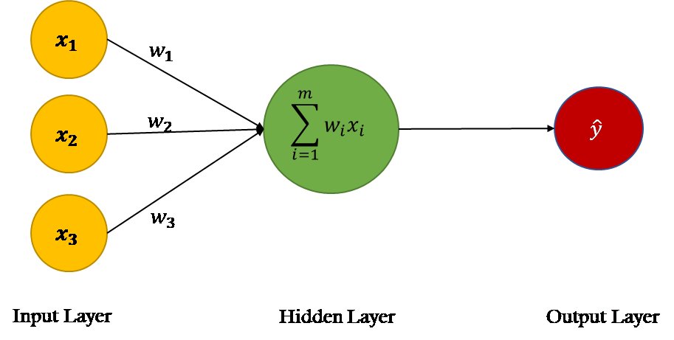
The Neuron

Slide 5
The Neural Network

Slide 6
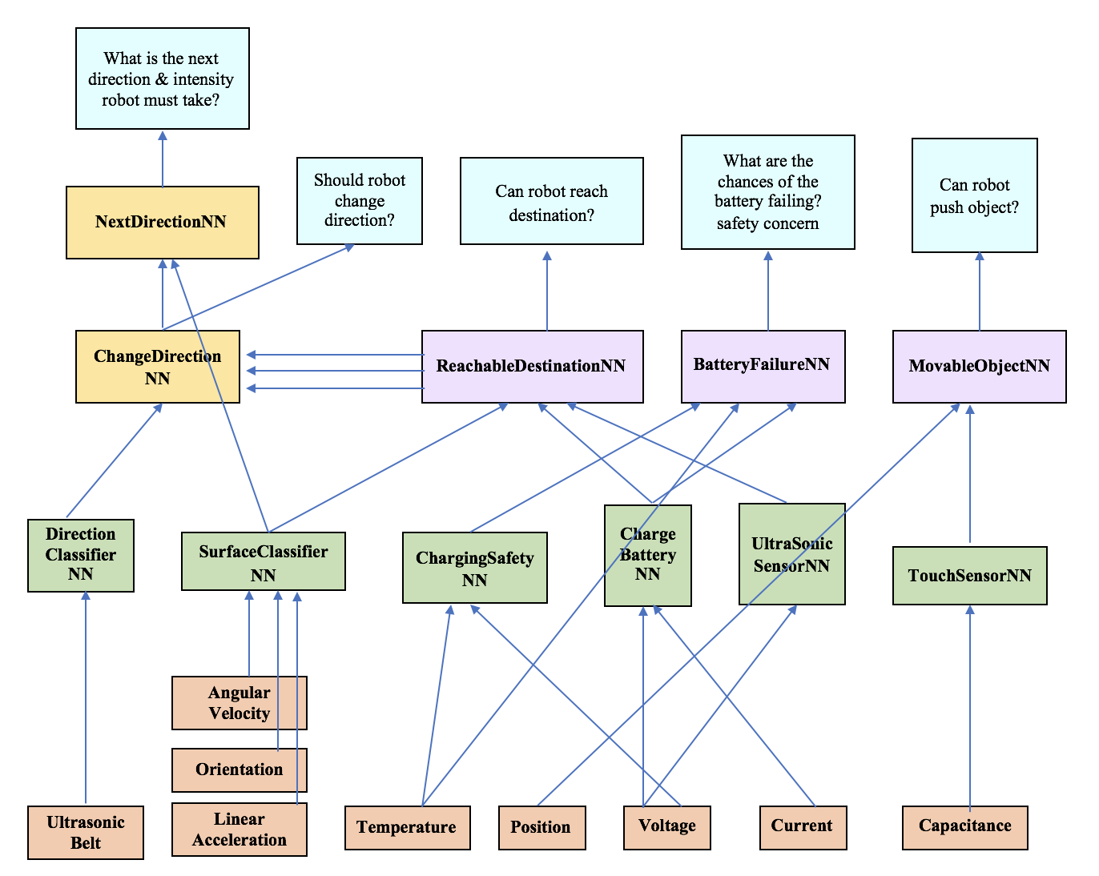
The Neural Network Tree

Slide 7
Tools
Java
Neuroph
JPanel
JUnit

Slide 8
Questions
How should the neural network tree be designed?
How does this tree compare, in accuracy and time, to a non-tree like structure?
What are the advantages/drawbacks of each structure?
Which structure would be better in allowing for future higher-level neural networks?
How effective is this tree neural network in guiding a robot to its destination? Does the size of the grid matter?
At what grid size can the robot no longer successfully reach its destination?
Would a typical path-traversal algorithm (e.g. depth-first-search) be more effective in guiding the robot?
How can a tree neural network work with such a path-traversal algorithm?

Slide 9
Methodology
Phase I:
Design the tree neural network (version 1)
Gather data for the first level neural networks, and implement them
Simulate data for the higher level neural networks, and implement them
Generate test cases and simulations for the individual neural networks
Phase II:
Design the non-tree like neural network (version 2)
Generate data for the non-tree like neural networks and implement them
Generate test cases for the non-tree like neural network
Compare version 1 and version 2
Phase III:
Design the DFS-based neural network (version 3)
Simulate the DFS neural network and version 1
Compare version 1 and version 3

Slide 10
Neural Network Tree (Version 1)

Slide 11
DirectionClassifierNN
SD_front | SD_left | SD_right | SD_back | Expected | Predicted | Outcome
1.687 | 0.445 | 2.332 | 0.429 | right | right | true
0.798 | 0.663 | 2.469 | 1.242 | right | right | true
1.567 | 0.459 | 1.82 | 0.554 | right | right | true
0.79 | 0.762 | 2.789 | 1.172 | right | right | true
0.761 | 0.49 | 1.754 | 1.145 | right | right | true
0.769 | 0.783 | 1.564 | 0.668 | right | right | true
0.811 | 0.435 | 1.423 | 0.394 | right | right | true
2.0 | 0.515 | 1.957 | 1.689 | forward | forward | true
0.831 | 0.761 | 1.441 | 0.769 | right | right | true
0.88 | 0.708 | 1.25 | 0.513 | right | right | true
0.846 | 0.446 | 1.925 | 1.339 | right | right | true
0.967 | 0.946 | 2.725 | 1.302 | left | right | false
1.54 | 0.452 | 1.839 | 1.025 | right | forward | false
0.962 | 0.669 | 1.566 | 0.725 | forward | forward | true
0.602 | 0.504 | 2.56 | 1.355 | right | right | true
2.491 | 0.49 | 1.797 | 1.194 | right | forward | false
0.823 | 0.789 | 1.319 | 2.603 | right | right | true
0.808 | 0.536 | 1.693 | 1.299 | forward | forward | true
1.252 | 0.597 | 1.567 | 0.924 | right | right | true
0.763 | 0.648 | 3.02 | 1.624 | right | right | true
Class | Percentage
right-turn | 54%
move forward | 40%
left-turn | 6%
Accuracy Rate: 17/20, 85%

Slide 12
SurfaceClassifierNN
orientation_x mean | orientation_x median | orientation_x max | … | orientation_total std | Class
-0.758666 | -0.758530 | -0.75822 | … | 0.000042 | fine concrete
-0.512057 | -0.512035 | -0.50944 | … | 0.000020 | concrete
Class | Percentage
concrete | 20.45%
soft_pvc | 19.21%
wood | 15.93%
tiled | 13.49%
fine_concrete | 9.53%
hard_tiles_large_space | 8.08%
soft_tiles | 7.80%
carpet | 4.96%
hard_tiles | 0.55%
Class | Percentage
low friction | 75.83%
high friction | 24.17%
Accuracy Rate: 19/20, 95%

Slide 13
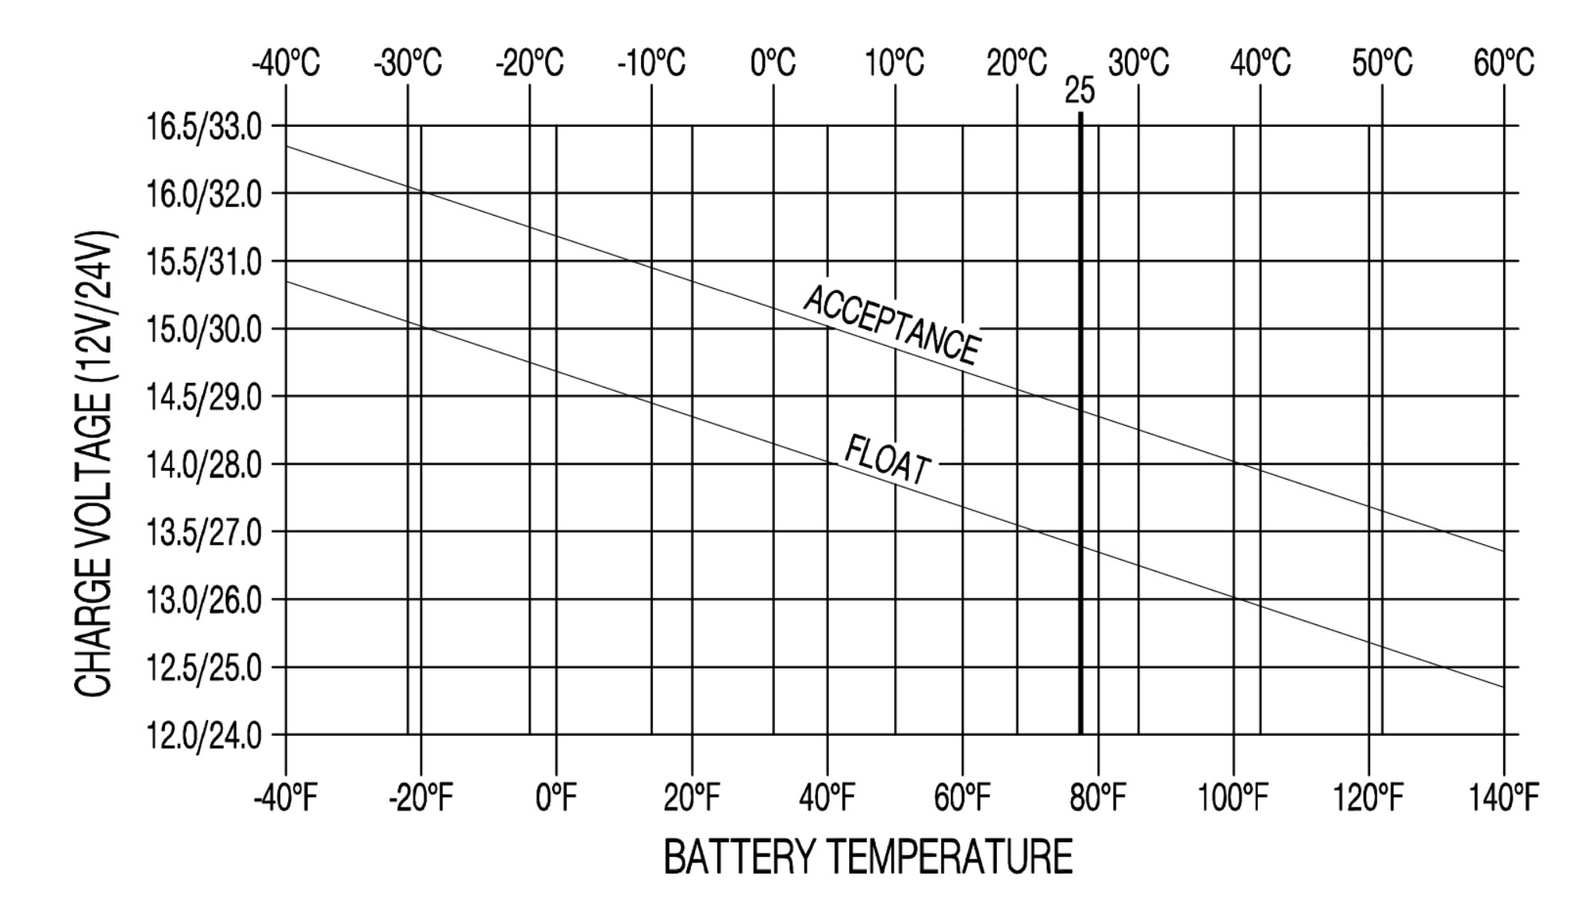
ChargingSafetyNN
Voltage (V) | Temperature (C) | Class | Outcome
16.25 | -39 | safe | true
15.4 | -7 | safe | true
14.95 | 5 | safe | true
14.3 | 28 | safe | true
13.9 | 40 | safe | false
13.25 | -40 | unsafe | true
13.75 | -28 | unsafe | true
14 | -20 | unsafe | true
14.5 | -4 | unsafe | true
16 | 30 | unsafe | true
Accuracy Rate: 9/10, 90%

Slide 14
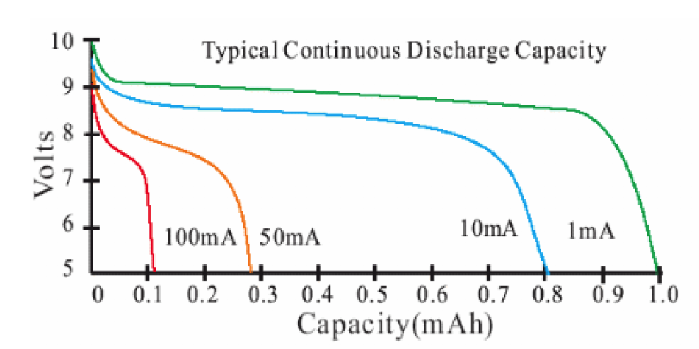
ChargeBatteryNN
Input current (mA) | Voltage (V) | Class | Outcome
1 | 9.75 | charge needed | true
1 | 8.25 | no charge | true
1 | 7.25 | no charge | true
1 | 6.25 | no charge | true
10 | 8.75 | charge needed | true
10 | 7.25 | no charge | true
10 | 6.25 | no charge | true
10 | 5.25 | no charge | true
50 | 9.15 | charge needed | true
50 | 8.25 | charge needed | true
50 | 7.25 | no charge | true
50 | 6.25 | no charge | true
50 | 5.25 | no charge | true
100 | 8.75 | charge needed | false
100 | 7.75 | charge needed | false
100 | 6.75 | no charge | true
100 | 5.75 | no charge | true
Accuracy Rate: 15/17, 88.24%

Slide 15
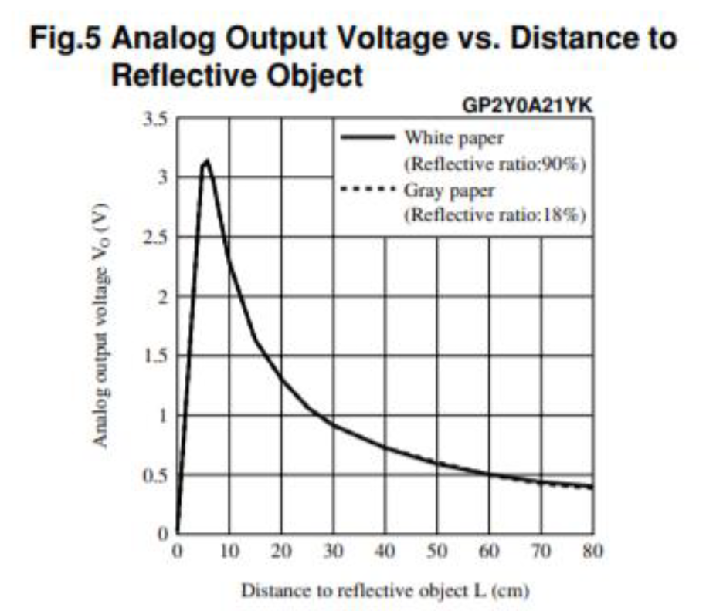
UltraSonicSensorNN
Voltage(V) | Class | Outcome
2.8 | close | true
2.6 | close | true
2.3 | close | true
2.15 | close | true
1.8 | far | true
1.6 | far | true
1.3 | far | true
1.26 | far | true
0.8 | far | true
0.6 | far | true
0.55 | far | true
Accuracy Rate: 11/11, 100%

Slide 16
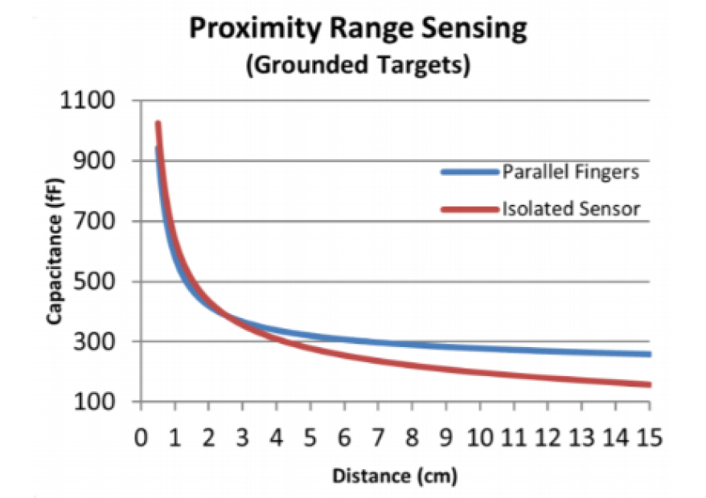
TouchSensorNN
Capacitance (fF) | Class | Outcome
600 | light touch | true
420 | light touch | true
360 | light touch | true
207 | hard touch | false
198 | hard touch | false
189 | hard touch | false
179 | hard touch | false
163 | hard touch | false
300 | light touch | true
235 | light touch | true
Accuracy Rate: 5/10, 50%

Slide 17
MovableObjectNN
TouchSensorNN (initial) | TouchSensorNN (final) | Position (initial) | Position (final) | Class | Outcome
0 | 0 | 0 | 0 | immovable | true
0 | 0 | 0 | 1 | movable | true
0 | 0 | 1 | 0 | immovable | true
0 | 0 | 1 | 1 | immovable | true
0 | 1 | 0 | 0 | immovable | true
0 | 1 | 0 | 1 | immovable | false
0 | 1 | 1 | 0 | immovable | true
0 | 1 | 1 | 1 | immovable | true
1 | 0 | 0 | 0 | immovable | true
1 | 0 | 0 | 1 | immovable | false
1 | 0 | 1 | 0 | immovable | true
1 | 0 | 1 | 1 | immovable | true
1 | 1 | 0 | 0 | immovable | true
1 | 1 | 0 | 1 | movable | true
1 | 1 | 1 | 0 | immovable | true
1 | 1 | 1 | 1 | immovable | true
Accuracy Rate: 14/16, 87.5%

Slide 18
BatteryFailureNN
Temperature (C) | ChargingSafetyNN | ChargeBatteryNN | Class | Outcome
-45 | safe | must charge | unlikely failure | true
-45 | unsafe | no need charge | likely failure | false
-45 | safe | no need charge | unlikely failure | true
-45 | unsafe | must charge | likely failure | true
-10 | safe | must charge | unlikely failure | true
-10 | safe | no need charge | unlikely failure | true
-10 | unsafe | no need charge | unlikely failure | true
-10 | unsafe | must charge | likely failure | true
20 | safe | must charge | unlikely failure | true
20 | safe | no need charge | unlikely failure | true
20 | unsafe | no need charge | unlikely failure | false
20 | unsafe | must charge | likely failure | true
45 | safe | must charge | unlikely failure | true
45 | safe | no need charge | unlikely failure | true
45 | unsafe | no need charge | likely failure | true
45 | unsafe | must charge | likely failure | true
Accuracy Rate: 14/16, 87.5%

Slide 19
ReachableDestinationNN
ChargeBatteryNN | UltraSonicSensorNN | SurfaceClassifierNN | Class | Outcome
must charge | close obstacle | low friction | unreachable | true
must charge | far obstacle | low friction | unreachable | true
must charge | far obstacle | high friction | unreachable | true
no need charge | close obstacle | low friction | unreachable | true
no need charge | close obstacle | high friction | unreachable | true
no need charge | far obstacle | low friction | reachable | true
no need charge | far obstacle | high friction | reachable | true
Accuracy Rate: 7/7, 100%

Slide 20
ChangeDirectionNN
ReachDestNN (left) | ReachDestNN (fwd) | ReachDestNN (right) | Class | Outcome
close | far | close | forward | true
far | far | close | forward | true
far | far | far | forward | true
close | far | far | forward | true
far | close | close | left | true
close | close | far | right | true
far | close | far | right | true
close | close | close | 180 - turn | true
Accuracy Rate: 8/8, 100%

Slide 21
NextDirectionNN
ChangeDirectionNN | SurfaceClassifierNN | Class | Outcome
forward | high friction | forward | true
forward | low friction | forward | true
right | high friction | sharp right-turn | true
right | low friction | slight right-turn | true
left | high friction | sharp left-turn | true
left | low friction | slight left-turn | true
Accuracy Rate: 6/6, 100%

Slide 22
Simulations

Slide 23
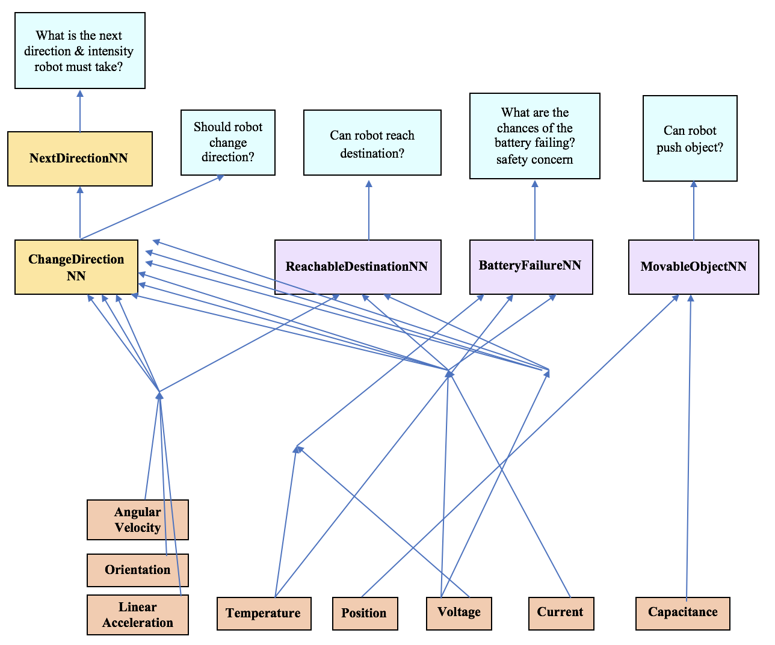
Neural Network (Version 2)

Slide 24
Version 1 vs Version 2
Neural Network | Accuracy (V1) | Training Time ms (V1) | Total Time (V1) | Accuracy (V2) | Training Time ms (V2) | Shorter Time | Higher Accuracy
BatteryFailureNN | 87.5% | 2371 | 3023 | 50% | 772 | V2 | V1
MovableObjectNN | 87.5% | 1395 | 1740 | 87.5% | 699 | V2 | V1=V2
ReachableDestinationNN | 100% | 54 | 26693 | 71.4% | 2188 | V2 | V1
ChangeDirectionNN | 100% | 832 | 27525 | 33.3% | 6466 | V2 | V1
ChargeBatteryNN=626ms
ChargingSafetyNN= 26ms
SurfaceClassifierNN= 25555ms
TouchSensorNN= 345ms
UltraSonicSensorNN=458ms

Slide 25
Comparison
Version 1
Disadvantages | Advantages
Errors are propagated | More customizability
Slow training time | Easy to replace neural networks
 | Easier to add future neural networks
 | Higher accuracy
Version 2
Disadvantages | Advantages
Little customizability | Faster training
Large Datasets (bias)

Slide 26
New Solution…

Slide 27
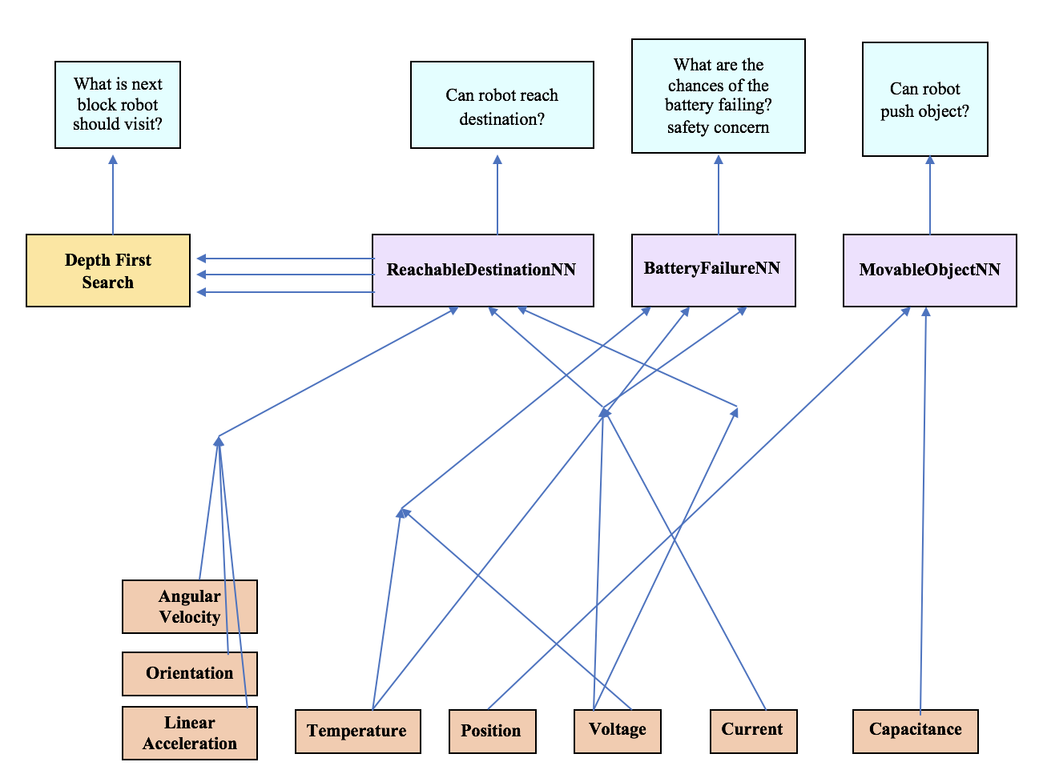
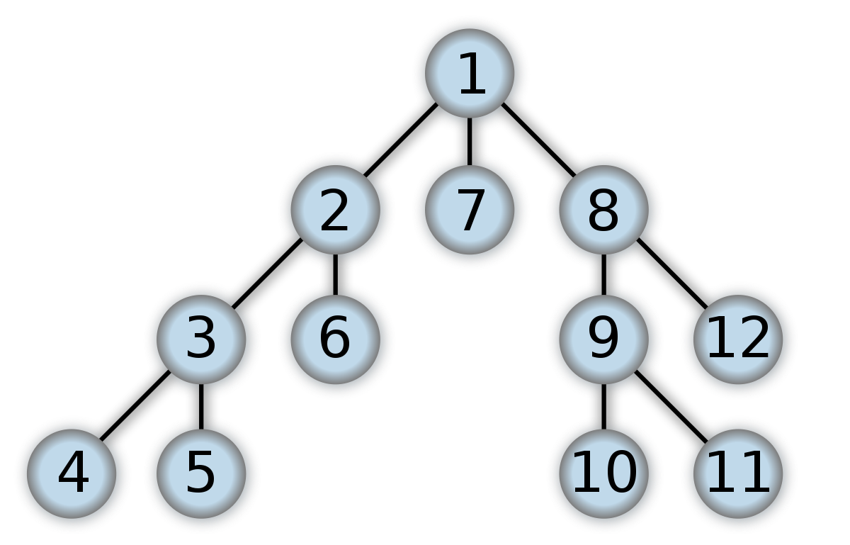
Neural Network Tree (Version 3)

Slide 28
Simulations

Slide 29
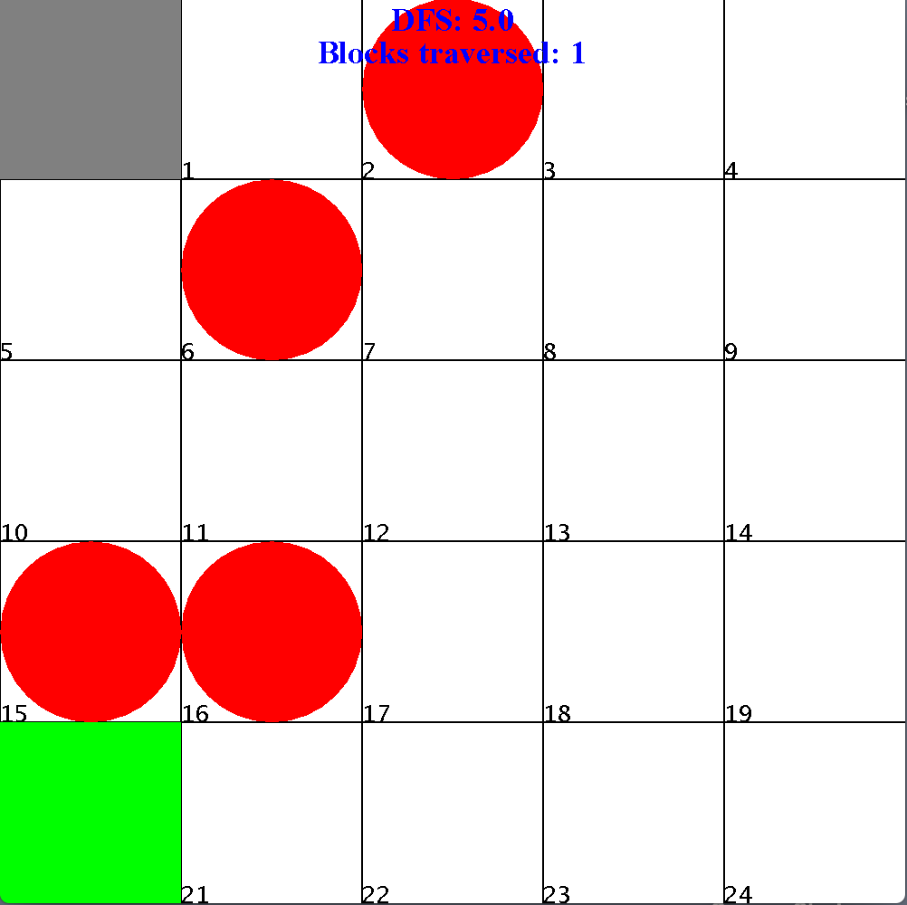
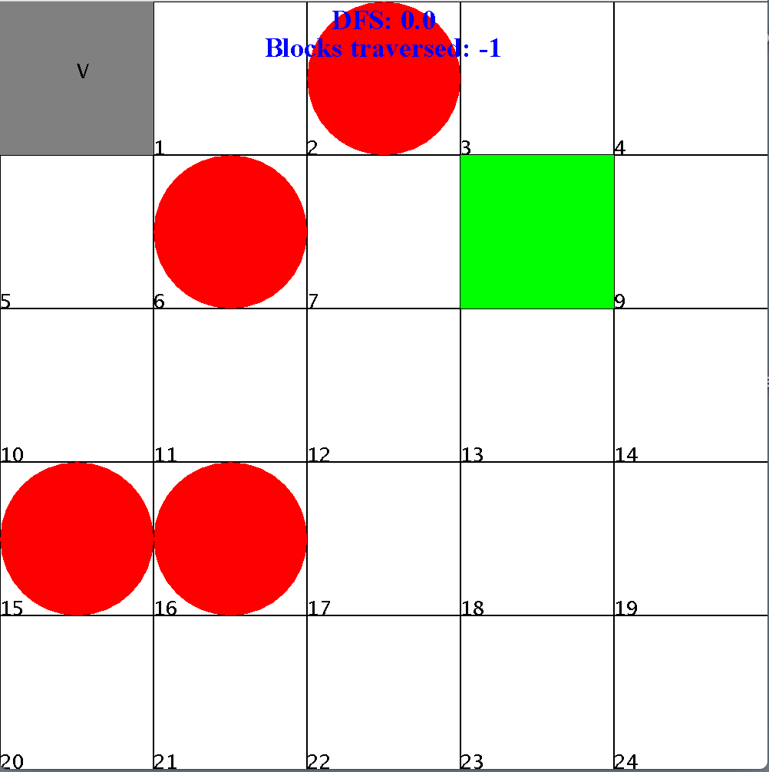
Simulation (example) Size: 5x5 Obstacles: 4 Destination: block 20 version 1: 15 blocks version 3: 31 blocks
Size: 5x5
Obstacles: 4
Destination: block 8
version 1: 25 blocks
version 3: 15 blocks

Slide 30
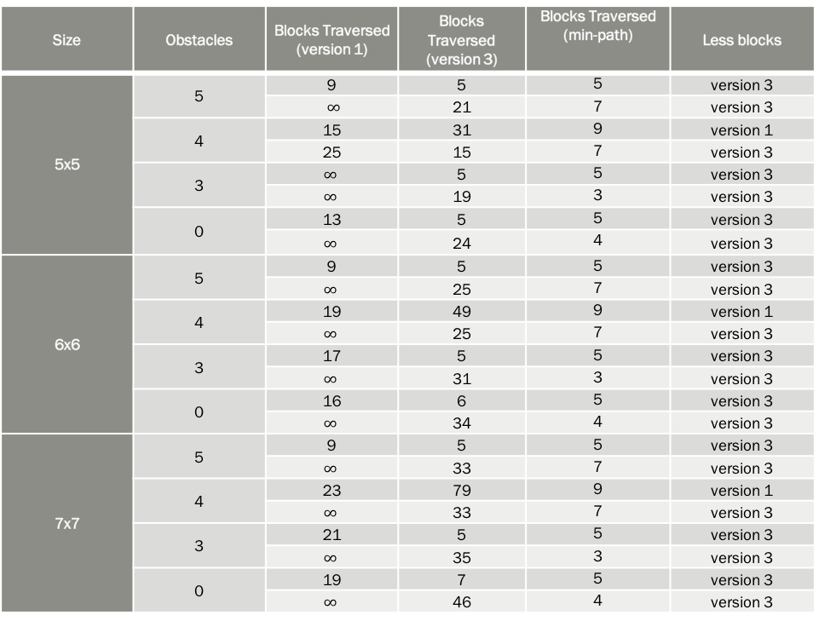
Version 1 vs Version 3
Size | Obstacles | Blocks Traversed (version 1) | Blocks Traversed (version 3) | Blocks Traversed (min-path) | Less blocks
5x5 | 5 | 9 | 5 | 5 | version 3
 |  | $∞$ | 21 | 7 | version 3
 | 4 | 15 | 31 | 9 | version 1
 |  | 25 | 15 | 7 | version 3
 | 3 | $$∞$$ | 5 | 5 | version 3
 |  | $$∞$$ | 19 | 3 | version 3
 | 0 | 13 | 5 | 5 | version 3
 |  | $$∞$$ | 24 | 4 | version 3
6x6 | 5 | 9 | 5 | 5 | version 3
 |  | $$∞$$ | 25 | 7 | version 3
 | 4 | 19 | 49 | 9 | version 1
 |  | $$∞$$ | 25 | 7 | version 3
 | 3 | 17 | 5 | 5 | version 3
 |  | $$∞$$ | 31 | 3 | version 3
 | 0 | 16 | 6 | 5 | version 3
 |  | $$∞$$ | 34 | 4 | version 3
7x7 | 5 | 9 | 5 | 5 | version 3
 |  | $$∞$$ | 33 | 7 | version 3
 | 4 | 23 | 79 | 9 | version 1
 |  | $$∞$$ | 33 | 7 | version 3
 | 3 | 21 | 5 | 5 | version 3
 |  | $$∞$$ | 35 | 3 | version 3
 | 0 | 19 | 7 | 5 | version 3
 |  | $$∞$$ | 46 | 4 | version 3

Slide 31
Version 1 vs Version 3
Both: For a fixed number of obstacles and a fixed destination, an increase in grid size corresponds to a greater, or equal, number of traversed blocks
Version 1: neural network tree has a success rate of only 12/24=50%.
Version 1: the robot has no incentive to explore the grid it is placed on
Version 1: The robot is more likely to locate the destination along the wall
Version 1: This does not imply that the robot is guaranteed to locate a destination along a wall or that the robot cannot locate destinations not in corners or along the walls
Version 3: depth-first-search is far from being closest to the minimum path algorithm.
Version 3: neural network structure is expectably more reliable and safer to use.

Slide 32
Conclusion: Summary

Slide 33
Conclusion: Future Work and Impact

Slide 34
To Conclude…

